Slide 1
Deep Learning for NLP Workshop
Jay Urbain, PhD
Professor, Department of Electrical Engineering and Computer Science
Milwaukee School of Engineering

Slide 2
Deep Learning for NLP Workshop
Deep Learning
NLP, why NLP is hard,
Lab 1 – Sentiment Classification
Text classification
NLP vocabulary
Embeddings
Network architectures: MLP, CNN, RNN
Model development and evaluation, review
Lab 2 – Language/Date Translation
Encoder-decoder
Attention
Network architecture: LSTM with attention
Model development and evaluation, review

Slide 3
WORKSHOP PERSPECTIVE
What this workshop is:
An intro to Natural Language Processing (NLP) using Deep Learning
Lectures followed by step-by-step hands-on exercises using Jupyter Notebooks, TensorFlow and Keras
Emphasis is on the hands-on exercises
Downloadable Docker image
This workshop is not:
Comprehensive review of NLP
Deep Learning from first principles
Extensive programming and knowledge of APIs

Slide 4
EXPECTATIONS
Assumptions:
Basic Python
Basic understanding of Machine Learning
Nice to have:
Some deep learning, any NLP experience
Consider working with a partner

Slide 5
HOPEFULL TAKE AWAYS
Ability to design a deep learning workflow to conduct NLP based text tasks
Have a template for creating your own sentiment analysis NLP research

Slide 6
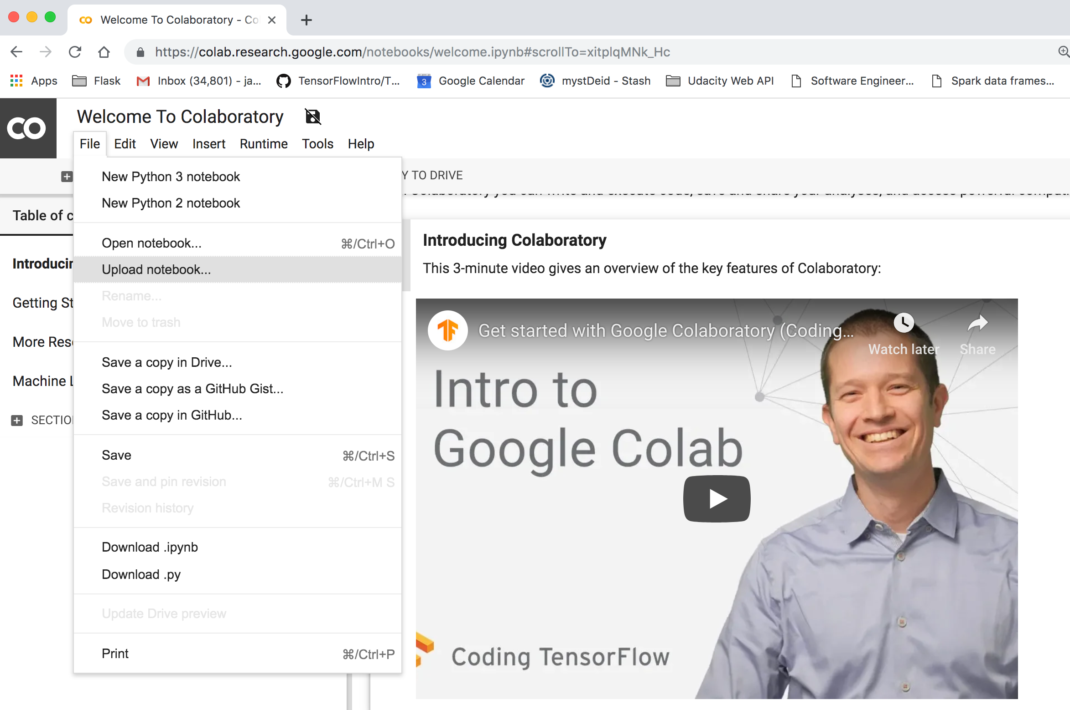
Running the NLP workshop labs
Option 1 (recommended) Google Colab:
Navigate to Google Colab:
https://colab.research.google.com/notebooks/welcome.ipynb

Slide 7
Running the NLP workshop labs
Google Colab continued:
Select File -> Upload notebook…

Slide 8
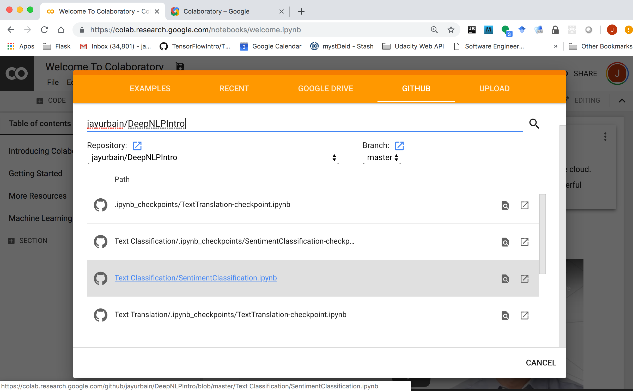
Running the NLP workshop labs
Select GITHUB.
Enter jayurbain/DeepNLPIntro
Select the TextClassification/SentimentClassification.ipynb notebook as follows:

Slide 9
Running the NLP workshop labs
Select GITHUB.
Enter jayurbain/DeepNLPIntro
Select the TextClassification/SentimentClassification.ipynb notebook as follows:

Slide 10
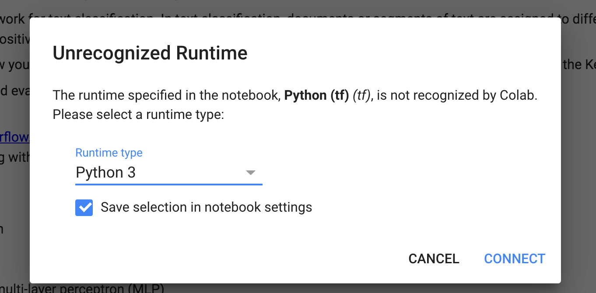
Running the NLP workshop labs
Select the Python 3 runtime environment.
Select Connect.

Slide 11
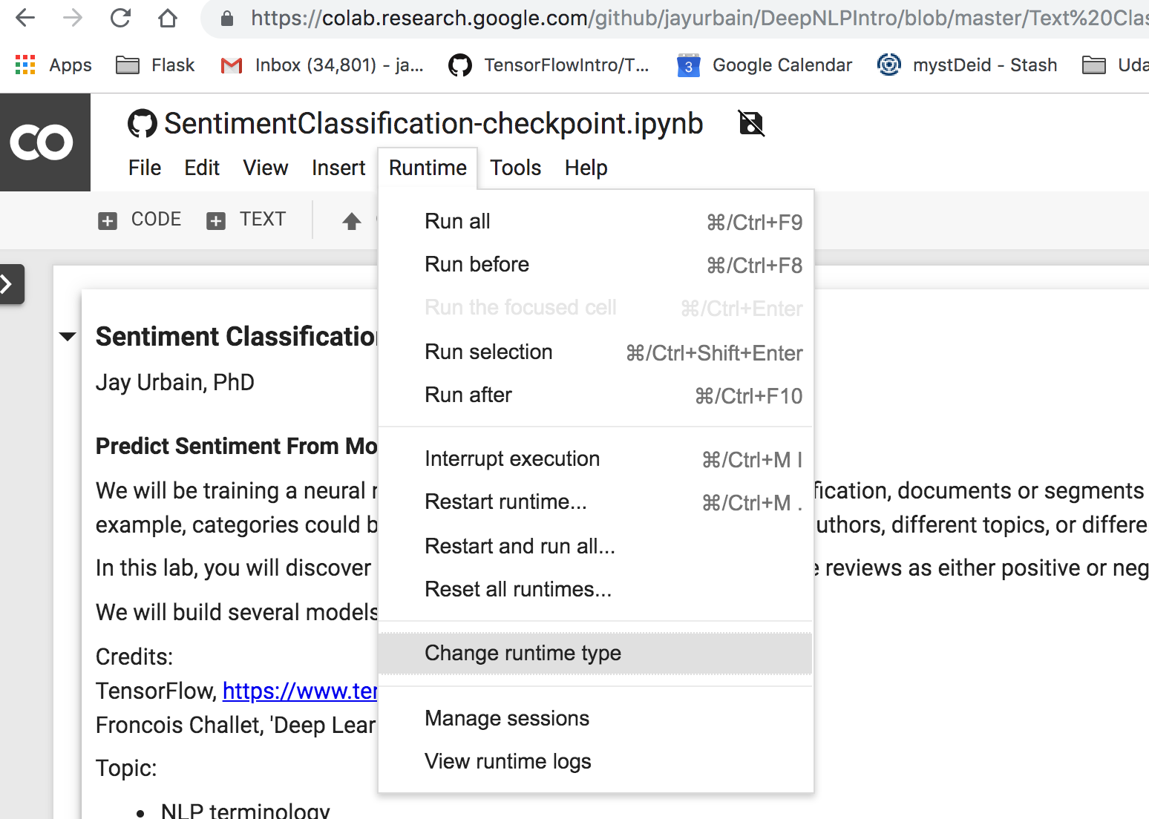
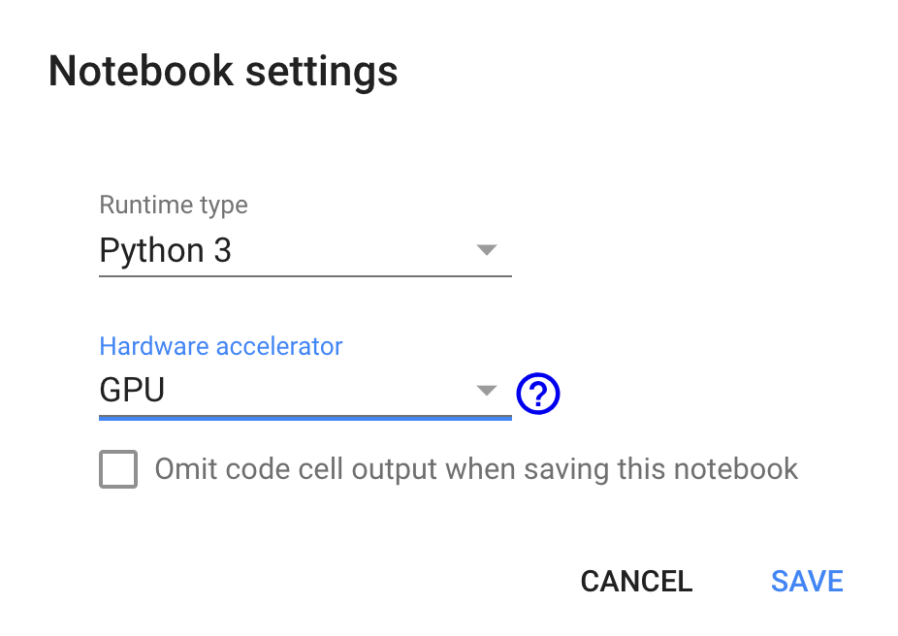
Running the NLP workshop labs
Optional: Select Runtime -> Change runtime type -> Hardware accelerator -> GPU, Save!

Slide 12
Running the NLP workshop labs
Option 2: Docker
1) Install Docker CE
https://www.docker.com/community-edition
2) Open a terminal and run Docker to launch the workshop image in a Docker container
$ docker run -p 8889:8888 jayurbain/deepnlpintro:latest
3) Open Chrome browser to localhost, port 8889, with the token
http://localhost:8889/?token=e1bc2fe905e1b0de7ec0820b03841c9d7d3bb434377540df

Slide 13
Running the NLP workshop labs
Option 3: Local repository
If you would prefer to set up your own environment, the lab exercises can be found at the following github repository:
https://github.com/jayurbain/DeepNLPIntro

Slide 14
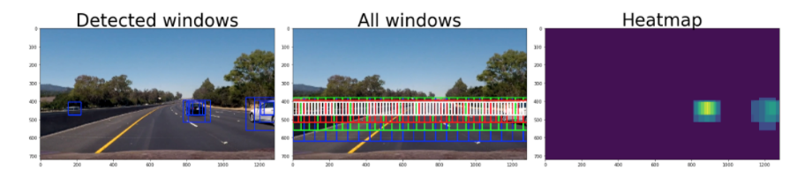
Intro to Deep Learning
Jay Urbain, PhD
Professor, Department of Electrical Engineering and Computer Science
Milwaukee School of Engineering

Slide 15

ACCOMPLISHING COMPLEX GOALS
Notes:
If we define intelligence as the ability to achieve complex goals, then learning is the ability to achieve more complex goals today than we could yesterday.
ML is an approach to AI that uses statistics techniques to construct a model from observed data. A machine-learning model transforms its input data into meaningful outputs, a process that is “learned” from exposure to known examples of inputs and outputs. Without being explicitly programmed.
DL is a ML technique that automates the creation of feature extractors using large amounts of data to train complex “deep neural networks”
DNNs are capable of achieving human-level accuracy for many tasks, but require tremendous computational power to train
A few years ago, researchers started applying DNNs in a variety of areas and reporting amazing results…
------------
In this course, you will begin to work with the fundamentals of Deep Machine Learning, using algorithms inspired by the human brain and strategies inspired by human learning to achieve our most complex goals by harnessing the power of parallel computing.
Artificial intelligence was born in the 1950s, the effort to automate intellectual tasks normally performed by humans.
A machine-learning system is trained rather than explicitly programmed. It’s presented with many examples relevant to a task, and it finds statistical structure in these exam- ples that eventually allows the system to come up with rules for automating the task.
ML is an approach to AI that uses statistics techniques to construct a model from observed data. A machine-learning model transforms its input data into meaningful outputs, a process that is “learned” from exposure to known examples of inputs and outputs. Without being explicitly programmed.
- There- fore, the central problem in machine learning and deep learning is to meaningfully transform data: in other words, to learn useful representations of the input data at hand—representations that get us closer to the expected output.
First, let’s start with some definitions…
AI is a broad field of study focused on using computers to do things that require human-level intelligence
It’s been around since the 50’s, playing games like tic-tac-toe and checkers, and inspiring scary sci-fi movies
But it was limited in practical applications
ML is an approach to AI that uses statistics techniques to construct a model from observed data
It generally relies on human-defined classifiers or “feature extractors” that can be as simple as a linear regression
Or slightly more complicated “Bag of Words” analysis that made email SPAM filters possible
Which was really handy in the late 1980’s when lots of email started showing up in your inbox
Ref. https://en.wikipedia.org/wiki/Naive_Bayes_spam_filtering
Then we invented smartphones, webcams, social media services and all kinds of sensors that generate huge mountains of “big data” and the new challenge of understanding and extracting insights from the data.

Slide 16
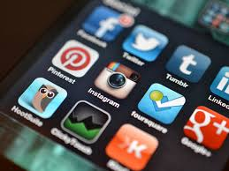
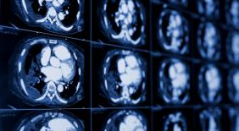

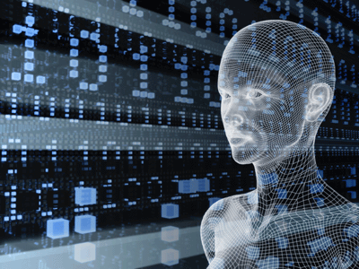
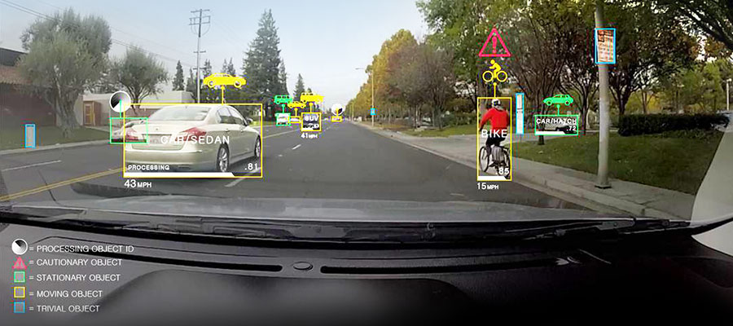
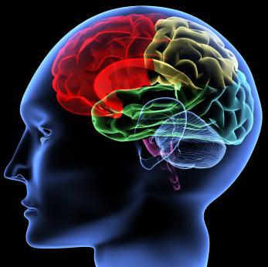
SWEEPING ACROSS INDUSTRIES
Internet Services
Medicine
Media & Entertainment
Security & Defense
Autonomous Machines
Image/Video classification
Speech recognition
Natural language processing
Cancer cell detection
Diabetic grading
Drug discovery
Video captioning
Content based search
Real time translation
Face recognition
Video surveillance
Cyber security
Pedestrian detection
Lane tracking
Recognize traffic signs
Notes:
It turns out that deep learning is stunningly effective across many domains by achieving goals that were once thought to be uniquely human. For example, it’s transforming the way computers achieve perceptual tasks such as computer vision, pattern detection, speech recognition and behavior prediction.
Deep learning powers consumer products like:
Facebook’s “DeepFace” feature creates a 3D model of your face from your online photos, adjusts for lighting and facial expressions, and identifies you in photos with 97% accuracy – all using deep learning. You may have experienced this when Facebook alerts you that a new picture of you has been posted and gives you the option to blur out your image.
References:
http://www.inquisitr.com/1825367/facebook-deepface-ai-learning-your-face-in-every-uploaded-photo
http://news.sciencemag.org/social-sciences/2015/02/facebook-will-soon-be-able-id-you-any-photo
Microsoft’s Skype Translator performs instant translation of conversations in over 40 languages, using Deep Learning to automatically transform your spoken words into text that can then be analyzed using standard translation methods.
References:
http://www.technologyreview.com/news/534101/something-lost-in-skype-translation/
http://www.wired.com/2014/05/microsoft-skype-translate/
Going beyond consumer benefits include medical researchers using deep learning to detect genes associated with autism spectrum disorder, neuroscientists to detect and suppress the brainwave patterns responsible for epileptic seizures, and other medical professionals using deep learning to identify skin cancers, classify lung sounds, and accelerate computational drug design, saving millions in research.
This is only the beginning. Imagine a day in the not-too-distant future when a service like Facebook puts this all together and notifies you that you may have early-stage skin cancer so you can consult with your doctor and get life-saving treatment.
===========================
Story: Understanding Video
Clarifai offers a service that rapidly analyzes images and video clips to recognize 10,000 different objects or types of scenes
This capability can be used for extremely targeted advertising, for example:
Showing a Starbucks ad whenever coffee appears in a video
Rapidly scanning security footage
Searching through your personal video archive for your child’s first steps
References:
http://www.technologyreview.com/news/534631/a-startups-neural-network-can-understand-video/
Some people, including Bloomberg and the World Economic Forums, have even started referring to it as the 4th industrial revolution.
References:
https://www.bloomberg.com/news/articles/2016-05-20/forward-thinking-robots-and-ai-spur-the-fourth-industrial-revolution
https://www.weforum.org/agenda/2016/01/the-fourth-industrial-revolution-what-it-means-and-how-to-respond/

Slide 17


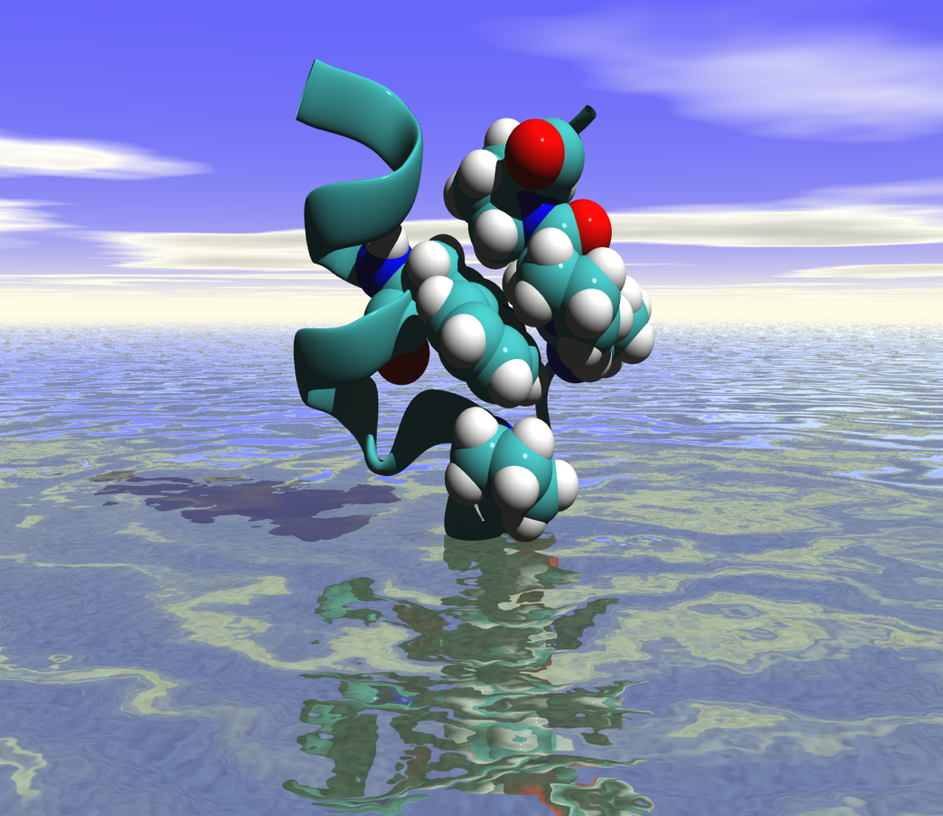





TRANSFORMING RESEARCH
92%
believe AI will impact their work
93%
using deep learning seeing positive results
“Seeing” Gravity In Real Time
Accelerating Drug Discovery
insideHPC.com Survey
November 2016
Notes:
Outside of industry, deep learning is changing the way we answer big questions.
“SEEING” GRAVITY IN REAL TIME
In September 2015, 100 years after Einstein predicted them, deep learning assisted astronomers in observing gravitational waves for the first time. “Seeing” gravity —a feat that Einstein doubted would ever be achieved— opened the door to a new class of astrophysics, along with daunting new challenges.
These new challenges are being faced with deep learning to process gravitational wave data more than 100 times faster than its previous machine learning methods — making real-time analysis possible and putting us one step closer to understanding the universe’s oldest secrets.
Accelerating Drug Discovery with AI
It takes an average of 12 years and $2.6 billion to bring a new drug to market. Effective and affordable medical care in the future will depend on breakthroughs to speed the process. Molecular energetics, where millions of molecules are scanned to determine how they interact with each other, promises to do just that, but it requires an enormous amount of computing power.
Today’s CPU-based methods can process as many as two million candidates per year, but researchers at the Universities of Florida and North Carolina have developed a way to use GPU-based deep learning to accomplish the same work in under two minutes. Its speed and accuracy could start a revolution in computational chemistry — and forever change the way we discover the medicines of the future.

Slide 18
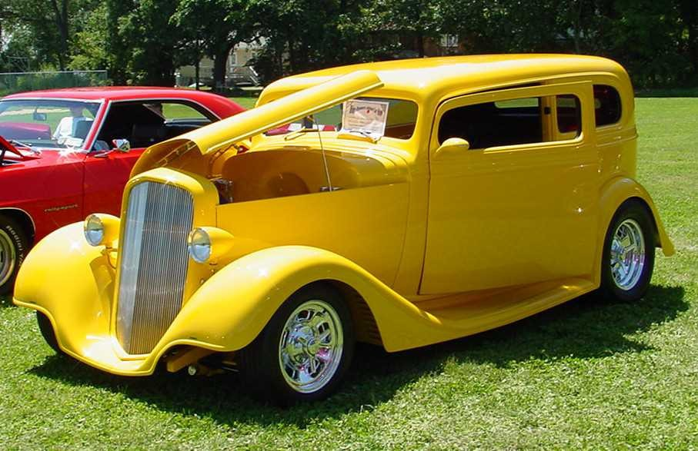
Deep learning =
Learning representations/features
The traditional model of pattern recognition (since the late 50's)
Fixed/engineered features (or fixed kernel) + trainable classifier
End-to-end learning / Feature learning / Deep learning
Trainable features (or kernel) + trainable classifier
Hand-crafted Feature Extractor
“Simple” Trainable Classifier
Trainable Feature Extractor
Trainable Classifier

Slide 19
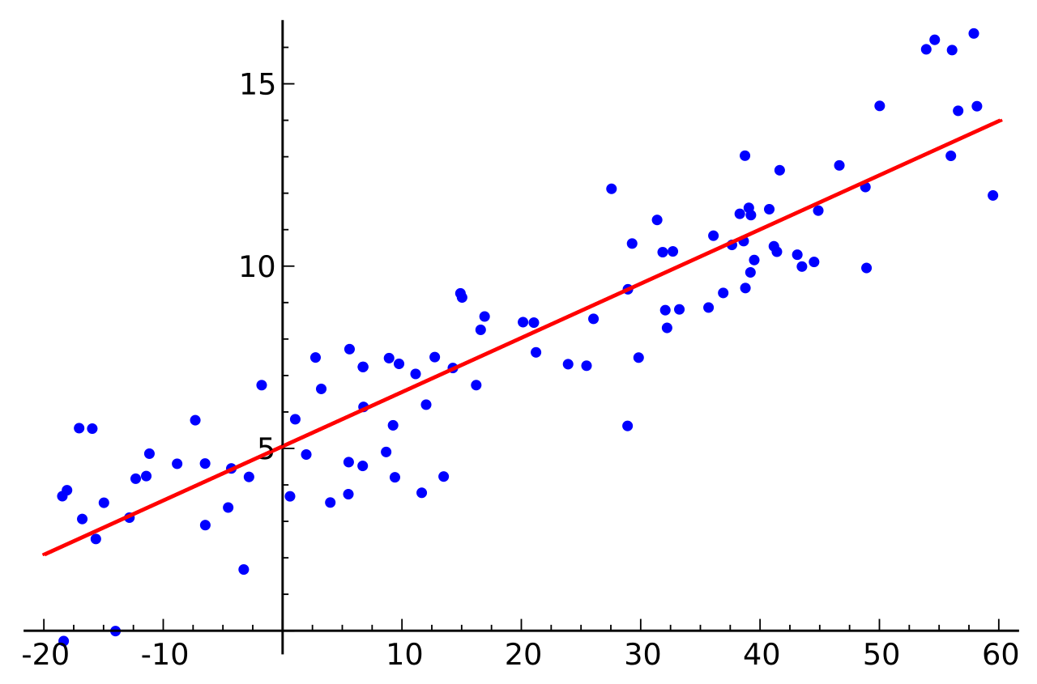
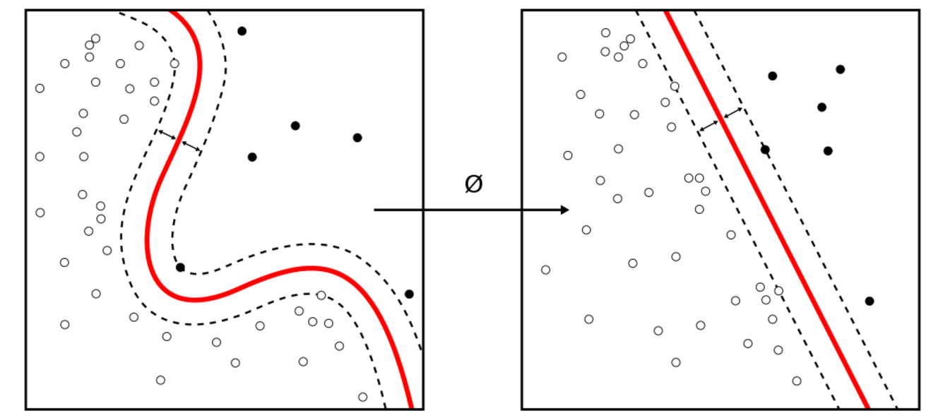
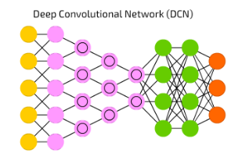
Difference in Workflow
Examples [ Regression and SVMs ]
Classic Machine Learning [ 1990 : now ]
Hand Designed Features
Model / Mapping
Input
Output
Deep/End-to-End Learning [ 2012 : now ]
Example [ Conv Net ]
Simple Features
Complex Features
Model/ Mapping
Input
Output
Machine learning workflow shifts from engineering features for “shallow” models
to architecting deep learning models with the ability to learn hierarchical representations of features
Notes:
image -> story/caption
pixels -> actions

Slide 20
Trainable feature hierarchy
Hierarchy of representations with increasing level of abstraction. Each stage is a kind of trainable feature transform
Image recognition
Pixel → edge → motif → part → object
Text
Character → word → word group → clause → sentence → story/semantic understanding
Speech
Sample → spectral band → sound → … → phone → phoneme → word
Trainable feature transform
Trainable feature transform
Trainable feature transform
Trainable feature transform

Slide 21
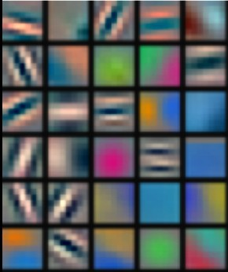
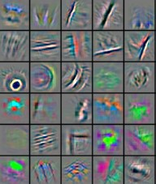
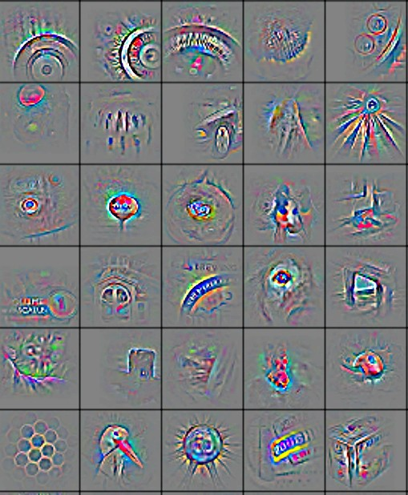
Deep learning = learning hierarchical representations
It's deep if it has more than one stage of non-linear feature transformation
Low-level feature
Mid-level feature
High-level feature
Trainable classifier
Feature visualization of convolutional net trained on ImageNet from [Zeiler & Fergus 2013]

Slide 22
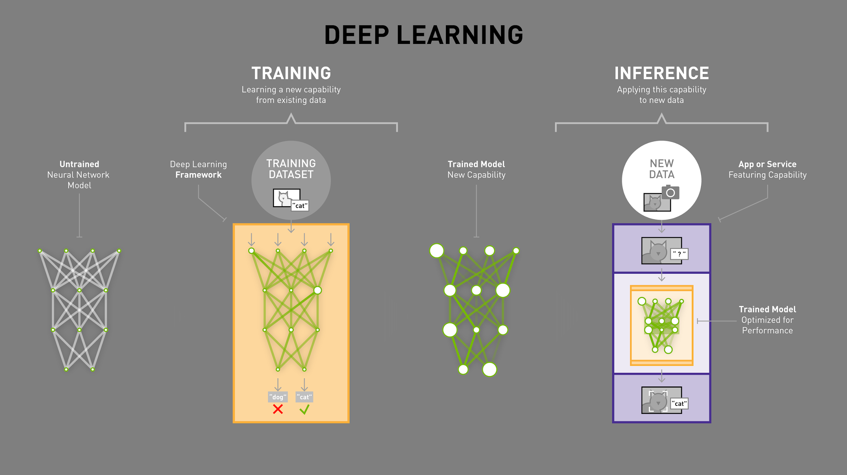
HOW IT WORKS
Notes:
Once the model has been trained, much of the generalized flexibility that was necessary during the training process is no longer needed, so it’s possible to optimize the model for significantly faster runtime performance.
[Story: How Cooper learned to classify cars, “tucks”, busses, motorcycles, etc.]
Common optimizations include fusing layers to reduce memory and communication overhead, pruning nodes that do not contribute significantly to the results, and other techniques supported in the NVIDIA TensorRT runtime.
The fully trained and optimized model is then ready to be integrated into an application that will feed it new data, in this case images of dogs and cats that it hasn’t seen before, and it will be able to quickly and accurately infer the correct answer based on its training. And your application can be deployed on a GPU-accelerated platform in your datacenter, in the cloud, on a local workstation, in a robot, a smart camera, or even a self-driving car.

Slide 23
Rationale for Deep Learning
Costs of acquiring and storing large quantities of heterogeneous data have dropped significantly.
The ability to extract actionable knowledge from such datasets has become critical for companies to maintain a competitive advantage.
Significant improvements in deep learning algorithms enabled by GPU processing provide new application opportunities across industries.
Deep Learning has set new performance standards in many machine learning applications.

